Slide 1
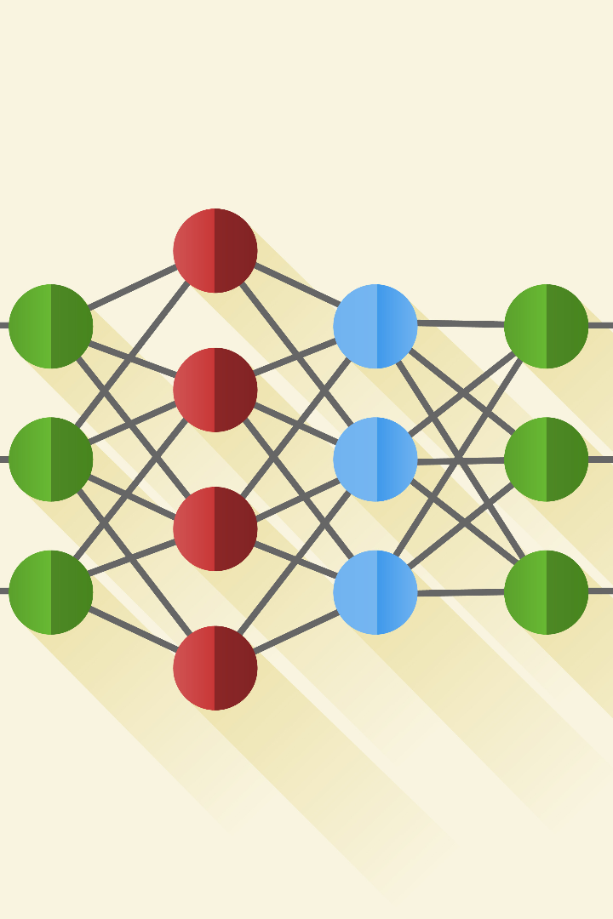
Convolutional Neural Networks (CNN) — Architecture
.
CM
by CHINCHU MS

Slide 2
A convolutional neural network (CNN), is a network architecture for deep learning which learns directly from data.
CNNs are particularly useful for finding patterns in images to recognize objects.
They can also be quite effective for classifying non-image data such as audio, time series, and signal data.
A Convolutional Neural Network (CNN) is a specialized type of deep learning model that is primarily used for image recognition and analysis.
It consists of multiple interconnected layers that perform convolutions, pooling, and feature extraction.
CNNs are highly effective in pattern recognition tasks due to their ability to automatically learn and extract relevant features from images.

Slide 3

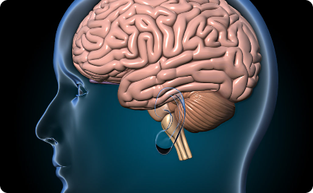
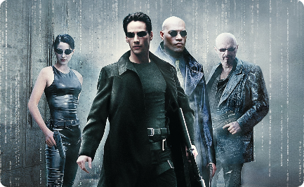
CNN Basics
Introduction
Neural Networks
Mathematics
CNNs are a type of AI model commonly used for image processing and recognition.
CNNs are inspired by the structure of the brain and its ability to process visual information.
CNNs use mathematical operations such as convolution and pooling to extract features from images.

Slide 4
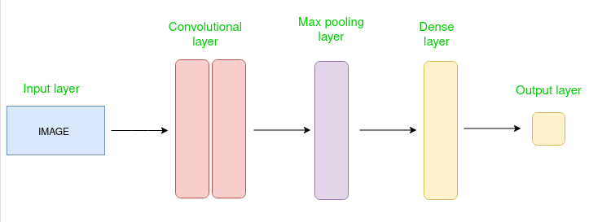
CNN architecture
Convolutional Neural Network consists of multiple layers like the input layer, Convolutional layer, Pooling layer, and fully connected layers
The Convolutional layer applies filters to the input image to extract features, the Pooling layer down samples the image to reduce computation, and the fully connected layer makes the final prediction.
The network learns the optimal filters through backpropagation and gradient descent.

Slide 5
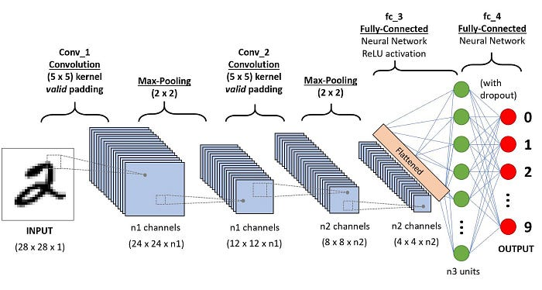

Slide 6
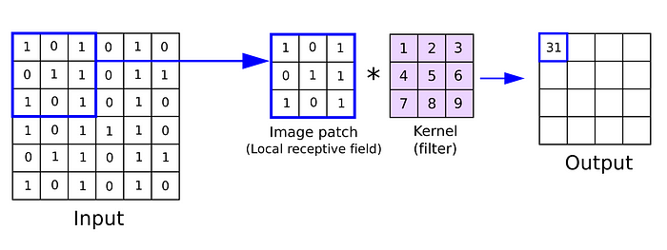
Kernel or Filter or Feature Detectors
In a convolutional neural network, the kernel is nothing but a filter that is used to extract the features from the images.
Formula = [i-k]+1
i -> Size of input , K-> Size of kernel

Slide 7
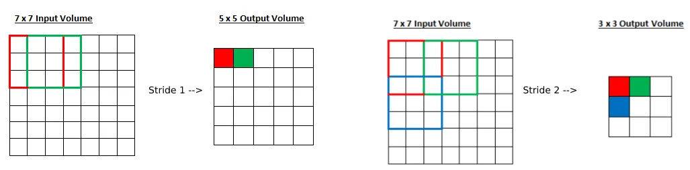
Stride
Stride is a parameter of the neural network’s filter that modifies the amount of movement over the image or video. we had stride 1 so it will take one by one. If we give stride 2 then it will take value by skipping the next 2 pixels.
Formula =[i-k/s]+1
i -> Size of input , K-> Size of kernel, S-> Stride

Slide 8
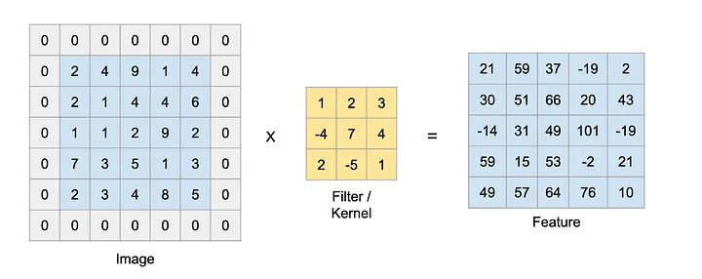
Padding
Padding is a term relevant to convolutional neural networks as it refers to the number of pixels added to an image when it is being processed by the kernel of a CNN. For example, if the padding in a CNN is set to zero, then every pixel value that is added will be of value zero. When we use the filter or Kernel to scan the image, the size of the image will go smaller. We have to avoid that because we want preserve the original size of the image to extract some low-level features. Therefore, we will add some extra pixels outside the image. Kindly use this link to learn more about padding.
Formula =[i-k+2p/s]+1
i -> Size of input , K-> Size of kernel, S-> Stride, p->Padding

Slide 9
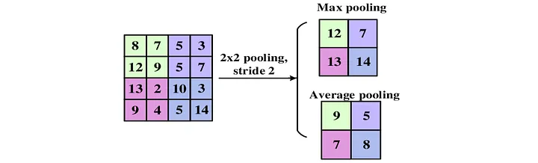
Pooling
Pooling in convolutional neural networks is a technique for generalizing features extracted by convolutional filters and helping the network recognize features independent of their location in the image.

Slide 10
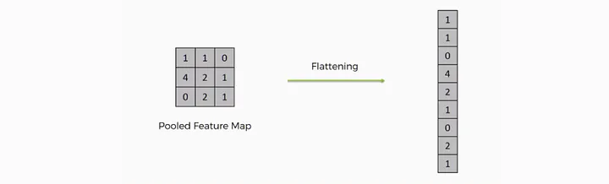
Flatten
Flattening is used to convert all the resultant 2-Dimensional arrays from pooled feature maps into a single long continuous linear vector. The flattened matrix is fed as input to the fully connected layer to classify the image.

Slide 11
Layers used to build CNN
Convolutional neural networks are distinguished from other neural networks by their superior performance with image, speech, or audio signal inputs. They have three main types of layers, which are:
Convolutional layer
Pooling layer
Fully-connected (FC) layer
Convolutional layer
This layer is the first layer that is used to extract the various features from the input images. In this layer, We use a filter or Kernel method to extract features from the input image.
Pooling layer
The primary aim of this layer is to decrease the size of the convolved feature map to reduce computational costs. This is performed by decreasing the connections between layers and independently operating on each feature map. Depending upon the method used, there are several types of Pooling operations. We have Max pooling and average pooling.

Slide 12
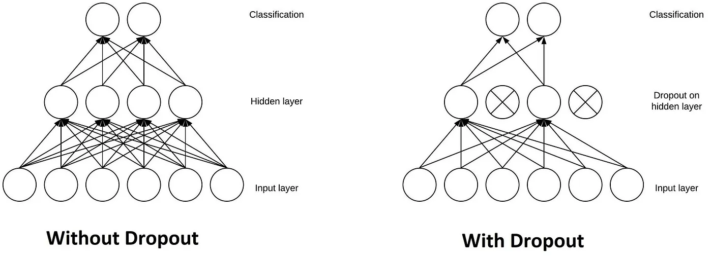
Fully-connected layer
The Fully Connected (FC) layer consists of the weights and biases along with the neurons and is used to connect the neurons between two different layers. These layers are usually placed before the output layer and form the last few layers of a CNN Architecture.
Dropout
Another typical characteristic of CNNs is a Dropout layer. The Dropout layer is a mask that nullifies the contribution of some neurons towards the next layer and leaves unmodified all others.

Slide 13
Activation Function
An Activation Function decides whether a neuron should be activated or not. This means that it will decide whether the neuron’s input to the network is important or not in the process of prediction. There are several commonly used activation functions such as the ReLU, Softmax, tanH, and the Sigmoid functions. Each of these functions has a specific usage.
Sigmoid — For a binary classification in the CNN model
tanH - The tanh function is very similar to the sigmoid function. The only difference is that it is symmetric around the origin. The range of values, in this case, is from -1 to 1.
Softmax- It is used in multinomial logistic regression and is often used as the last activation function of a neural network to normalize the output of a network to a probability distribution over predicted output classes.
RelU- the main advantage of using the ReLU function over other activation functions is that it does not activate all the neurons at the same time.

Slide 14
Convolutional Layers
Purpose
Operations
Convolutional layers apply filters to an image and create feature maps that reduce the dimensionality of the image.
Convolutions involve multiplying a small matrix (the filter) with each pixel of the image and summing the results.
Filters and Feature Maps
Examples
Filters are small feature detectors that are applied to the image. Feature maps show the locations of the detected features.
Applications of convolutional layers include image classification, object detection, and image segmentation.

Slide 15
Pooling Layers
1
Importance
Pooling layers reduce the size of the feature maps and make them more robust to small variations in the image.
2
Techniques
Common pooling techniques include max pooling (selecting the maximum value in each region), average pooling (averaging the values in each region), and L2 pooling (taking the square root of the sum of squares of the values in each region).
3
Downsampling
Pooling layers perform downsampling, which reduces the dimensionality of the network and helps prevent overfitting.

Slide 16
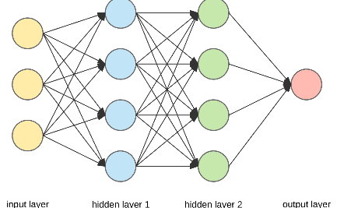
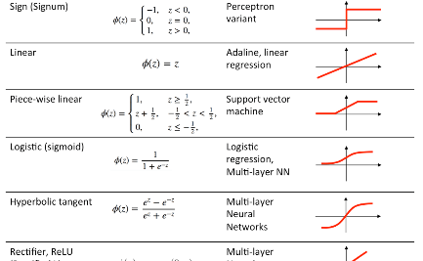
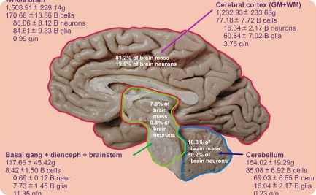
Fully Connected Layers
Role
Activation Functions
Number of Neurons
Fully connected layers connect all the neurons in one layer to all the neurons in the next layer. They perform the final classification or regression of the input data.
Activation functions introduce non-linearity into the model and allow it to learn complex representations of the input data.
The number of neurons in each layer affects the complexity and capacity of the model. Determining the optimal number of neurons requires experimenting and testing.

Slide 17
Advantages of Convolutional Neural Networks (CNNs):
Good at detecting patterns and features in images, videos, and audio signals.
Robust to translation, rotation, and scaling invariance.
End-to-end training, no need for manual feature extraction.
Can handle large amounts of data and achieve high accuracy.
Disadvantages of Convolutional Neural Networks (CNNs):
Computationally expensive to train and require a lot of memory.
Can be prone to overfitting if not enough data or proper regularization is used.
Requires large amounts of labeled data.
Interpretability is limited, it’s hard to understand what the network has learned.

Slide 18
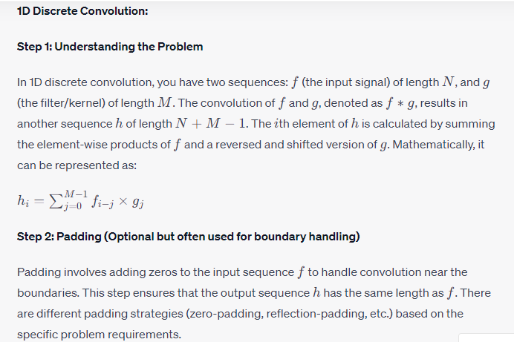
Efficient Convolution Algorithm
Convolutional layers apply filters to an image and create feature maps that reduce the dimensionality of the image.

Slide 19
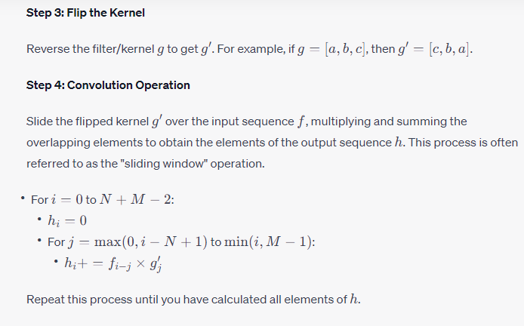
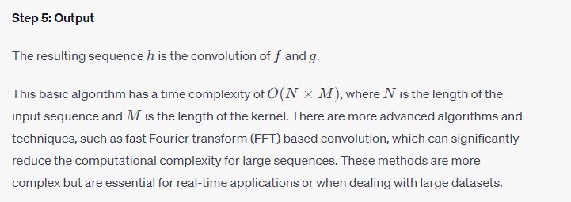

Slide 20
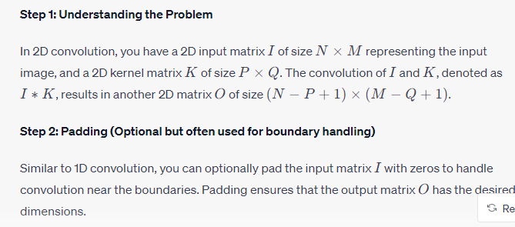
2D convolution is a fundamental operation in image processing and computer vision. It involves convolving a 2D input image matrix with a 2D kernel (also known as a filter or mask) to produce a 2D output image. The convolution operation is used for various tasks such as edge detection, blurring, sharpening, and feature extraction in images.

Slide 21


